Slide 1
Customer churn prediction
Group Members:
Sajeevan Kumarasamy
Omolara Titilayo Adesina
Mordecai Kobla Mawunyegah Quashigah
Rina Hashimoto

Slide 2
Introduction
Customer churn has emerged as a major issue in every industry
The best churn management helps to identify the potential churners and understanding what kind of factors make them to leave the company
A data set consists of customer information collected from a credit card portfolio was used to predict the customer segment who are potential to churn in a banking industry
Various visualization techniques and methods will be used to identify the pattern and behaviors’ of potential churners

Slide 3
Data handling process
Set the objectives
Set the objectives
Import the Data
Identify the problem
Import the Data
Identify the problem
Identify the problem
Visualization and Interpretation
Visualization and Interpretation
Visualization and Interpretation
Analyse the Data
Clean the Data
Clean the Data
Model the data
Evaluation

Slide 4
Objectives
Descriptive Objectives
How the socio-economic factors such as Gender, Age, Education, Marital status, and Income affect the customers to churn?
How the relationship with bank such as Card category, Credit limit, and Active months affect the customers to churn?
How the spending pattern of customers have impact on churn?
Identify the factors which have direct impact on customer churn?
Predictive Objectives
Fit the model to predict the customer churn using the identified factors which have impact on customer churns

Slide 5
Data cleaning process
Import the data: R studio has been used for data cleaning
Missing value treatment: No missing value found in the data set
Duplicate removal approach: No duplicates found in the data set
Outlier Treatment:
Box plot was used to identify which variables has outliers
The variables Customer_age, Credit_Limit, Avg_Open_To_Buy, Total_Trans_Amt, Total_Trans_Ct, abd Total_Ct_Chng_Q4_Q1 have outliers
The below two approaches has been considered to treat the outliers
Delete the outliers: Delete the entire records of the outliers. This cannot be performed as the numbers of data for the analysis massively reduce which may cause biasness
Replace the outliers with mean: As few variables has a quite number of outliers and replacing them with the mean will cause biasness.

Slide 6
Data cleaning process
Recategorization of categorical variables:
Variable age has been categorized into few categories
A new variable called ‘age_group’ has been created and saved the categories into it
Transform Variables
Factorize categorical variables such as Gender, Education level, Marital Status, Income category
Transform variables to numeric

Slide 7
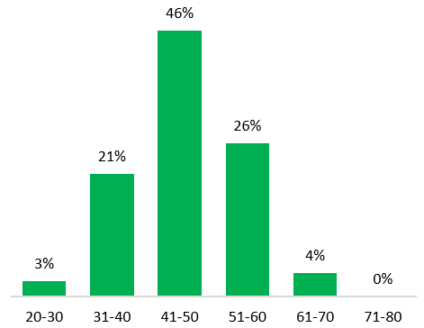
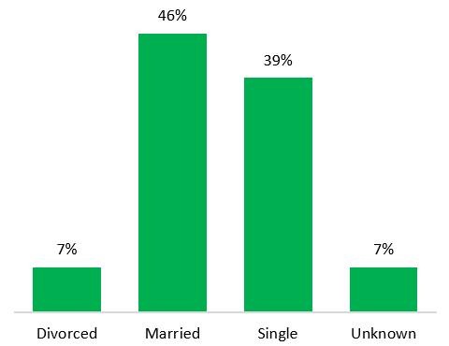
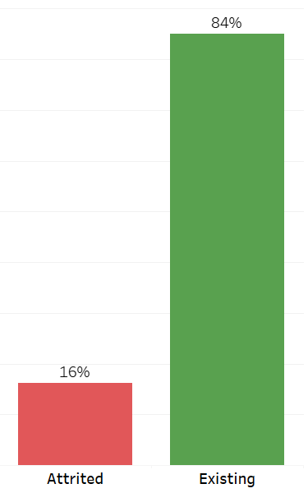
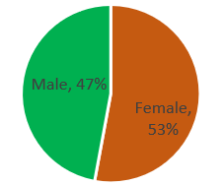
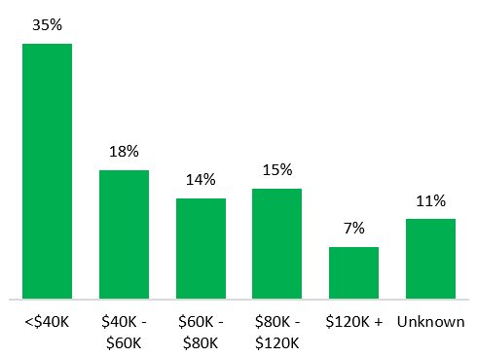
Distribution of customers
Gender Distribution
Distribution by Age
Distribution by Marital Status
Distribution by Customer type
Distribution by Income Category
The data consists of 14% of churners and the remaining 84% are existing customers
Majority of the users are females
Majority of the users are between 41 to 50 years and are married
35% of the users are earning less than $40K and only 7% of the users are earning more than $120K

Slide 8
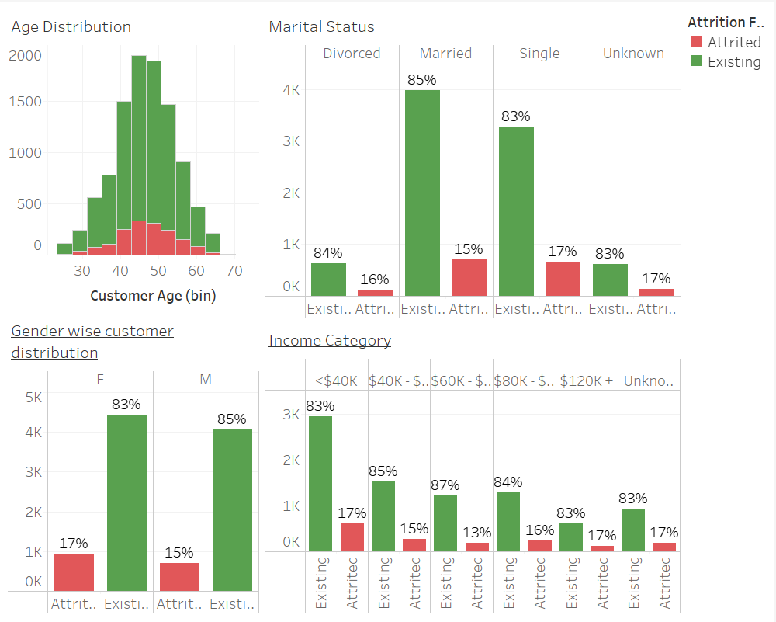
How demographic factors impact on customer churn?
Churn is higher among female customers
Distribution of age follows the same pattern for both existing and churned customers
Churn is higher among single customers and the second highest is among divorced customers
Churn is higher among low income and higher income group. Lowest churn is among the customers who earn between $60K-$80K

Slide 9
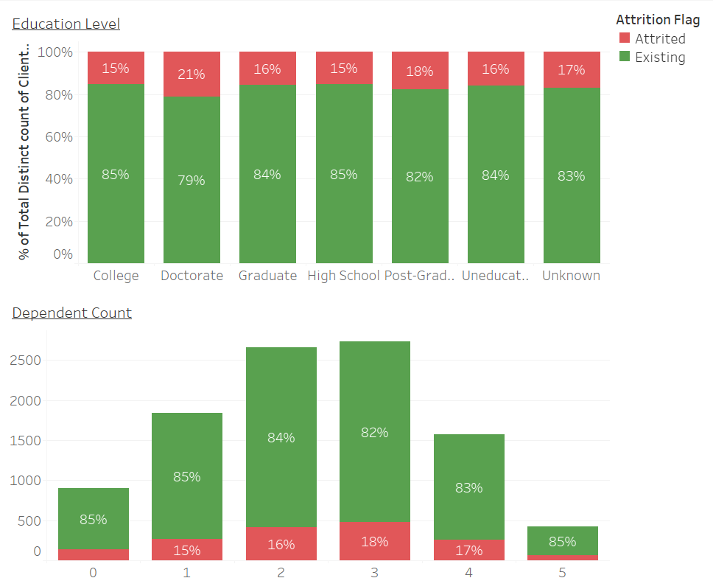
How demographic factors impact on customer churn?
Churn is higher among customers who have Doctorate (21%) and low among users who have completed College and high school (15.2%)
Churn is higher among the customers who have 3 dependents and low among 1 dependent

Slide 10
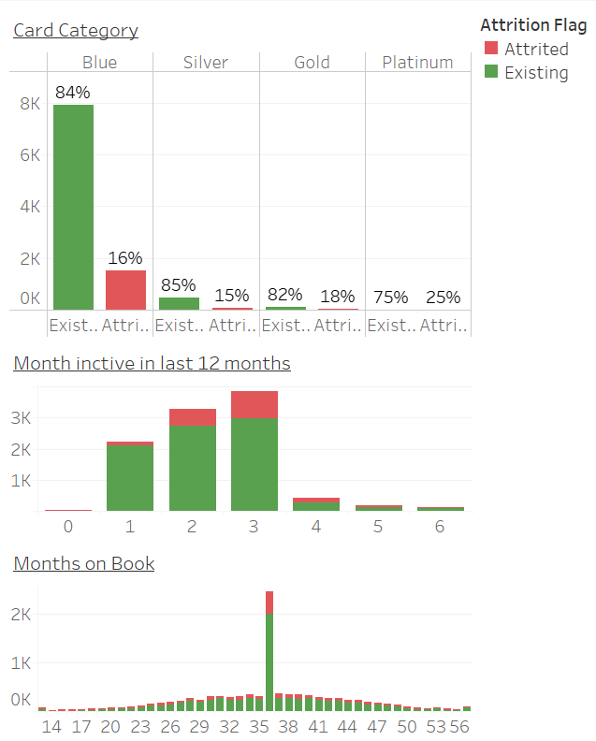
How relationship with card provider impact on customer churn?
Platinum card users have higher Churn rate (25%) and Silver card users have lower churn rate (14.8%)
It shows the card category has an impact on customer churn
Customer who are with the bank for around 3 years have tend to churn more (17%).
Churn is very low among the customers with the bank for less than 1 year
The customers inactive for less than 3 months tend to churn more compared to users who use the card frequently

Slide 11
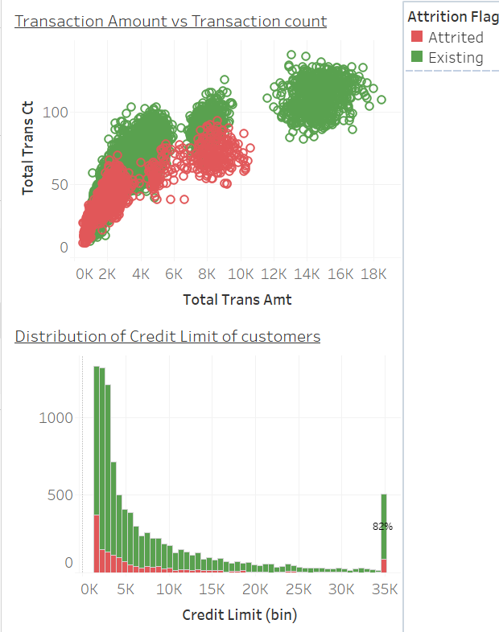
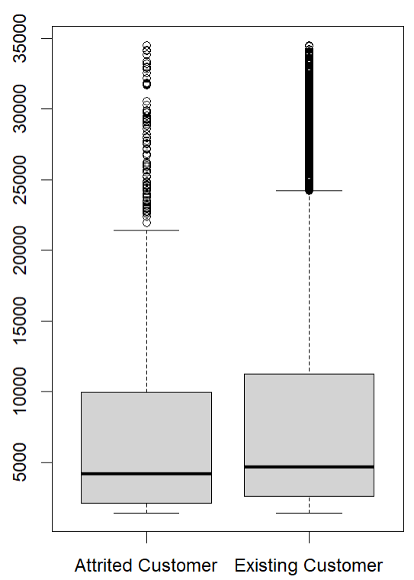
How spending pattern impact on customer churn?
Transaction count and amount has a linear relationship
Churned customers spend less amount and do lesser number of transaction compared to existing customers
Churn is higher among the customer who have lowest credit limit and the customer who have credit limit of more than $30K
Median of credit limit is lower in churned group comparing to existing users

Slide 12
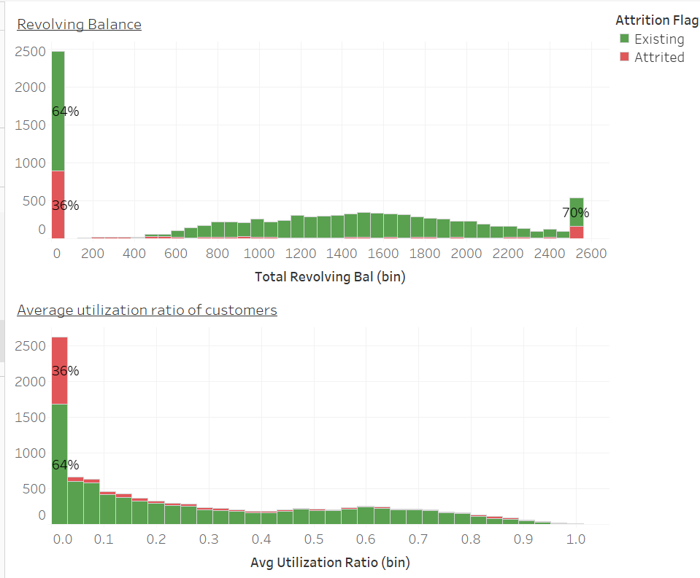
How spending pattern impact on customer churn?
The customers who are churned either having zero outstanding balance or having more than 2500 of outstanding debt
The customer churn is higher among customers who have low utilization ratio

Slide 13
Churn prediction model
Logistic regression was modelled to predict the customers who are potential to churn
The data set has been divided randomly in to two sets as Train and Test
Train data set was used to model and the test data set was used to test the mode for accuracy
Using this model potential churners can be identified, and necessary steps would be implemented to prevent them from leaving

Slide 14
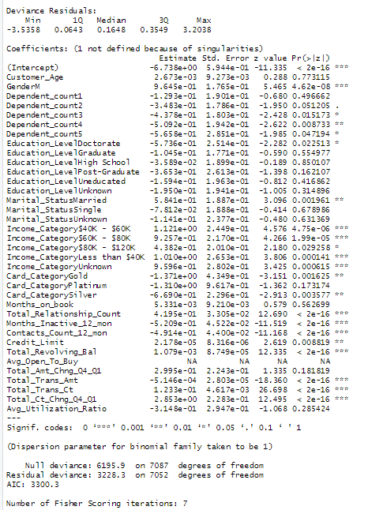
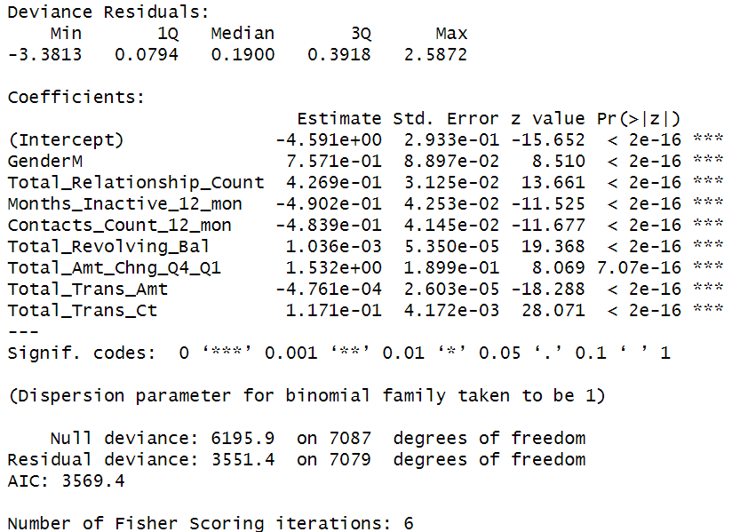

Churn prediction model
Initially all the variables were used for modelling (output: image 1)
Variables which has lower p value were selected for model 2
McFadden R was calculated for the fitted model. Since it was higher than 0.4 the fitted model was considered to predict the customer churn
Image 1
Image 2

Slide 15
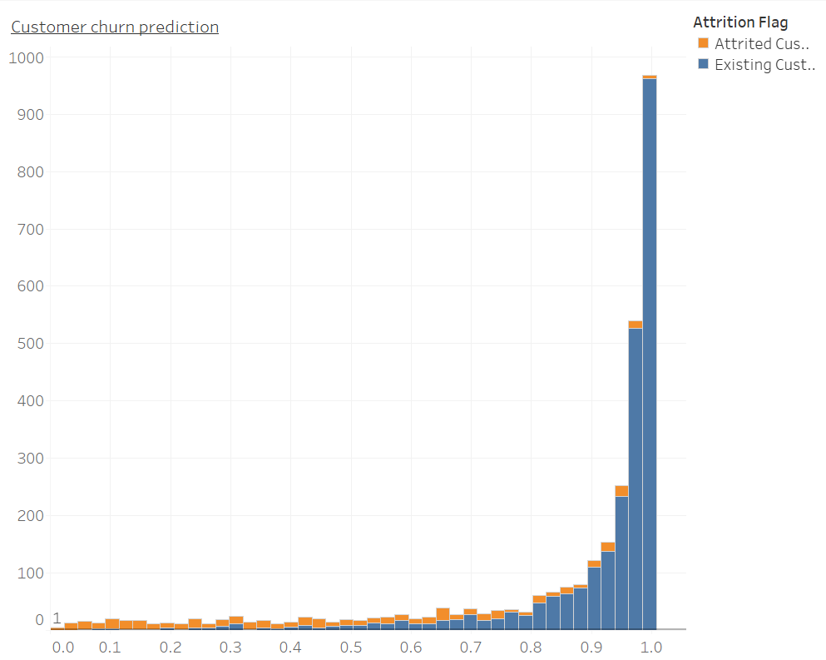
Churn prediction
Test data set was used to predict the customer churn using the above fitted logistic regression
Predicted churn and the customer category was analyzed
If the prediction is less than 0.65 the potential to churn is high
66% of the customers actually churned out of customers who expected to churn from the fitted model (<0.65)

Slide 16
Summary
Customers who earn less have potential to churn, also the customers who have doctorate are tend to churn more
Age and marital status do not have any impact on customer churn
Gold and Platinum card users have higher chances to churn
The customers who actively using the card before they making the decision to leave
Customers who are potential to churn have higher credit limit with higher outstanding balance
It concluded that the fitted model can be used to predict the customer churn

